Slide 1
Regularization
Overfitting (review)
Overfitting with linear models
Regularization of linear models
Regularized regression in scikit-learn
Regularized classification in scikit-learn
Comparing regularized linear models with unregularized linear models

Slide 2
overfitting
What is? | How does it occur | Impact | General characteristics
Building a model that matches the training data "too closely“ | Evaluating a model by testing it on the same data that was used to train it | Model will do well on the training data, but won't generalize to out-of-sample data | Low model complexity High bias, low variance
Learning from the noise in the data | Creating a model that is "too complex" | Model will have low bias, but high variance

Slide 3
causes
Irrelevant features | Correlated features | Large coefficients
Linear models can overfit if you include "irrelevant features", meaning features that are unrelated to the response. Why ? Because it will learn a coefficient for every feature you include in the model. | Linear models can overfit if the included features are highly correlated with one another, producing high variance | Linear models can overfit if the coefficients (after feature standardization) are too large. Why? Because the larger the absolute value of the coefficient, the more power it has to change the predicted response, resulting in a higher variance.
This is especially a problem when p (number of features) is close to n (number of observations), because that model will naturally have high variance.

Slide 4
Regularization of linear models
Regularization is a method for "constraining" or "regularizing" the size of the coefficients, thus "shrinking" them towards zero.
It reduces model variance and thus minimizes overfitting.
If the model is too complex, it tends to reduce variance more than it increases bias, resulting in a model that is more likely to generalize.

Slide 5
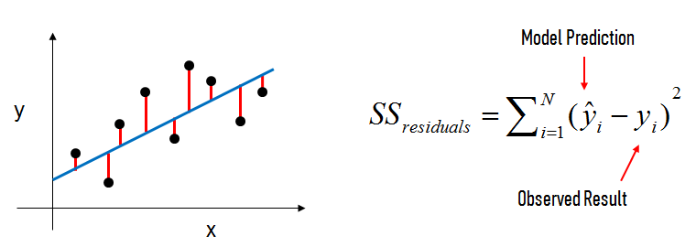

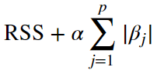
How does regularization work?
For a normal linear regression model, we estimate the coefficients using the least squares criterion, which minimizes the residual sum of squares (RSS):
Ridge regression
(or "L2 regularization") minimizes:
p is the number of features
βj is a model coefficient
α is a tuning parameter: Increasing the α penalizes the coefficients and thus shrinks them.
Lasso regression
(or "L1 regularization") minimizes:

Slide 6
Advice for applying regularization
Should features be standardized? | choose between Lasso regression and Ridge regression
Yes, because otherwise, features would be penalized simply because of their scale. | Lasso regression is preferred if we believe many features are irrelevant or if we prefer a sparse model.
 | If model performance is your primary concern, it is best to try both.
 | ElasticNet regression is a combination of lasso regression and ridge Regression.

Slide 7
Visualizing regularization
what happens when we apply regularization?
The general idea is that we are restricting the allowed values of the coefficients to a certain "region".
Within that region, we want to find the coefficients that result in the best model.

Slide 8
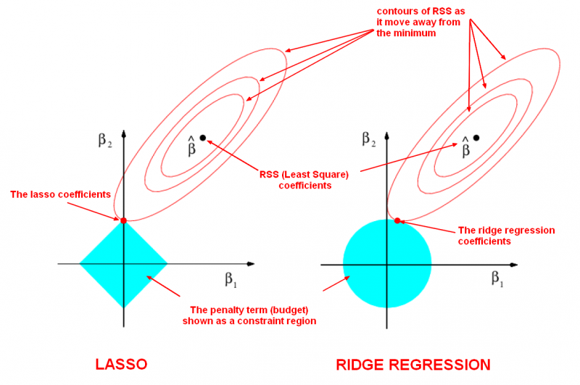
Explanation
Regularization restricts the allowed positions of β̂ to the blue constraint region:
For lasso, this region is a diamond because it constrains the absolute value of the coefficients.
For ridge, this region is a circle because it constrains the square of the coefficients.
The size of the blue region is determined by α, with a smaller α resulting in a larger region
When α is zero, the blue region is infinitely large, and thus the coefficient sizes are not constrained.
When α increases, the blue region gets smaller and smaller.

Slide 9
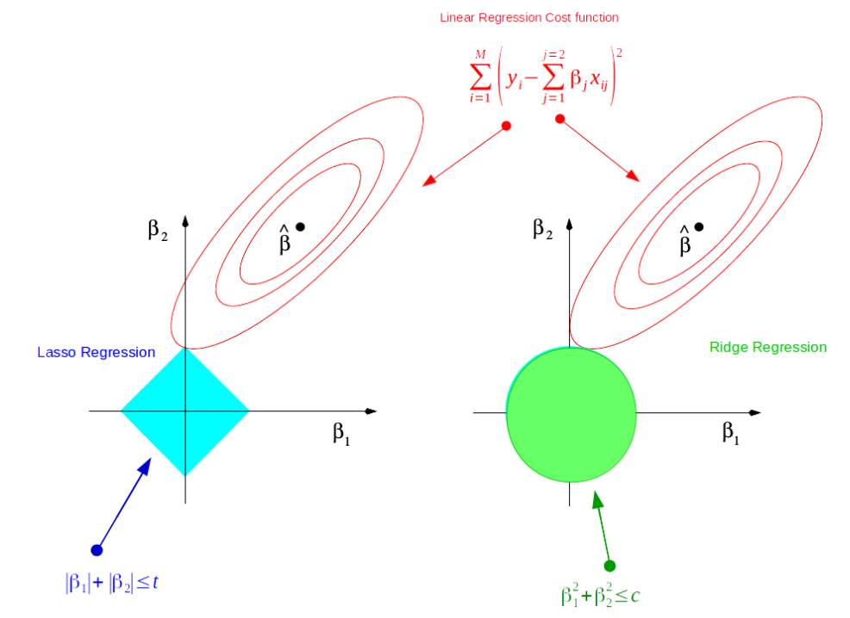
Explanation
For a 2 dimensional feature space, the constraint regions are plotted for Lasso and Ridge regression with cyan and green colors.
The elliptical contours are the cost function of linear regression
Now if we have relaxed conditions on the coefficients, then the constrained regions can get bigger and eventually they will hit the center of the ellipse. This is the case when Ridge and Lasso regression resembles linear regression results.
Otherwise, both methods determine coefficients by finding the first point where the elliptical contours hit the region of constraints.
The diamond (Lasso) has corners on the axes, unlike the disk, and whenever the elliptical region hits such point, one of the features completely vanishes!

